Slide 1
Cryptography and Network Security
Third Edition
by William Stallings
Lecture slides by Lawrie Brown

Slide 2
Chapter 5 –Advanced Encryption Standard
"It seems very simple."
"It is very simple. But if you don't know what the key is it's virtually indecipherable."
—Talking to Strange Men, Ruth Rendell

Slide 3
Origins
clear a replacement for DES was needed
  have theoretical attacks that can break it
  have demonstrated exhaustive key search attacks
can use Triple-DES – but slow with small blocks
US NIST issued call for ciphers in 1997
15 candidates accepted in Jun 98
5 were shortlisted in Aug-99
Rijndael was selected as the AES in Oct-2000
issued as FIPS PUB 197 standard in Nov-2001
Notes:
The AES candidates are the latest generation of block ciphers, and now we see a significant increase in the block size - from the old standard of 64-bits up to 128-bits; and keys from 128 to 256-bits. In part this has been driven by the public demonstrations of exhaustive key searches of DES. Whilst triple-DES is regarded as secure and well understood, it is slow, especially in s/w.

Slide 4
AES Requirements
private key symmetric block cipher
128-bit data, 128/192/256-bit keys
stronger & faster than Triple-DES
active life of 20-30 years (+ archival use)
provide full specification & design details
both C & Java implementations
NIST have released all submissions & unclassified analyses

Slide 5
AES Evaluation Criteria
initial criteria:
  security – effort to practically cryptanalyse
  cost – computational
  algorithm & implementation characteristics
final criteria
  general security
  software & hardware implementation ease
  implementation attacks
  flexibility (in en/decrypt, keying, other factors)
Notes:
Initial criteria were issued with call, and used to evaluate field of 15 candidates to select shortlist of 5.
The final criteria were used to select Rijndael from that short-list.

Slide 6
AES Shortlist
after testing and evaluation, shortlist in Aug-99:
  MARS (IBM) - complex, fast, high security margin
  RC6 (USA) - v. simple, v. fast, low security margin
  Rijndael (Belgium) - clean, fast, good security margin
  Serpent (Euro) - slow, clean, v. high security margin
  Twofish (USA) - complex, v. fast, high security margin
then subject to further analysis & comment
saw contrast between algorithms with
  few complex rounds verses many simple rounds
  which refined existing ciphers verses new proposals
Notes:
The shortlist is as shown. Note mix of commercial (MARS, RC6, Twofish) verses academic (Rijndael, Serpent) proposals, sourced from various countries.
All were thought to be good – came down to best balance of atatributes to meet criteria.

Slide 7
The AES Cipher - Rijndael
designed by Rijmen-Daemen in Belgium
has 128/192/256 bit keys, 128 bit data
an iterative rather than feistel cipher
  treats data in 4 groups of 4 bytes
  operates an entire block in every round
designed to be:
  resistant against known attacks
  speed and code compactness on many CPUs
  design simplicity
Notes:
Rijndael is an academic submission, based on the earlier Square cipher, from Belgium academics Dr Joan Daemen and Dr Vincent Rijmen.
It is an iterative cipher (operates on entire data block in every round) rather than feistel (operate on halves at a time). cf IDEA cipher

Slide 8
Rijndael
processes data as 4 groups of 4 bytes (state)
has 9/11/13 rounds in which state undergoes:
  byte substitution (1 S-box used on every byte)
  shift rows (permute bytes between groups/columns)
  mix columns (subs using matrix multipy of groups)
  add round key (XOR state with key material)
initial XOR key material & incomplete last round
all operations can be combined into XOR and table lookups - hence very fast & efficient
Notes:
Data is written into the state matrix by columns; this matrix is manipulated at stage of the en/decryption process, and is then finally copied to the output.
The key is expanded into 44/52/60 lots of 32-bit words (see later), with 4 used in each round.
The data computation then consists of an “add round key” step, then 9/11/13 rounds with all 4 steps, and a final 10th/12th/14th step of byte subs + mix cols + add round key. All steps are easily reversed.
Note only the “add round key” step makes use of the key and obscures the result, hence MUST be used at start and end of each round, since otherwise could undo effect of other steps. But the other steps provide confusion/diffusion/non-linearity. ie can look at cipher as a series of XOR with key then scramble/permute block repeated. This is efficient and highly secure it is believed.

Slide 9
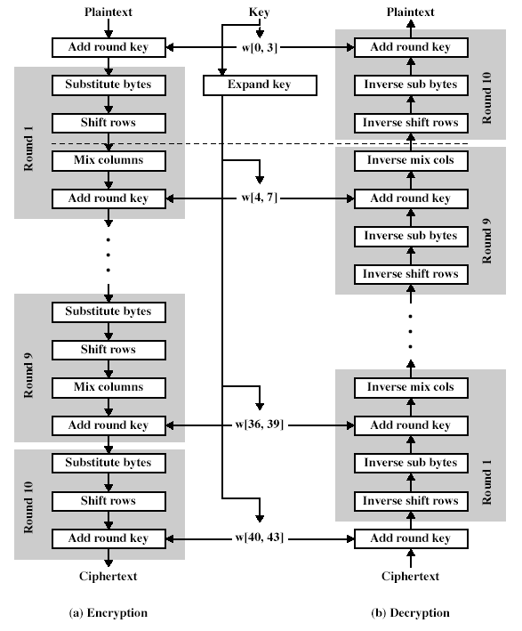
Rijndael

Slide 10
Byte Substitution
a simple substitution of each byte
uses one table of 16x16 bytes containing a permutation of all 256 8-bit values
each byte of state is replaced by byte in row (left 4-bits) & column (right 4-bits)
  eg. byte {95} is replaced by row 9 col 5 byte
  which is the value {2A}
S-box is constructed using a defined transformation of the values
designed to be resistant to all known attacks
Notes:
There is a single 8-bit wide S-box used on every byte. This S-box is a permutation of all 256 8-bit values, constructed using a transformation which treats the values as polynomials in GF(2⁸) – however it is fixed, so really only need to know the table when implementing. Decryption requires the inverse of the table.

Slide 11
Shift Rows
a circular byte shift in each each
  1st row is unchanged
  2nd row does 1 byte circular shift to left
  3rd row does 2 byte circular shift to left
  4th row does 3 byte circular shift to left
decrypt does shifts to right
since state is processed by columns, this step permutes bytes between the columns
Notes:
This step provides “permutation” of the data, whereas the other steps involve substitutions.

Slide 12

Mix Columns
each column is processed separately
each byte is replaced by a value dependent on all 4 bytes in the column
effectively a matrix multiplication in GF(2⁸) using prime poly m(x) =x⁸+x⁴+x³+x+1
Notes:
This step is also a substitution, but one involving ALL values in a column. Designed as a matrix multiplication where each byte is treated as a polynomial in GF(2⁸). The inverse used for decryption involves a different set of constants.
The constants used are based on a linear code with maximal distance between code words – this gives good mixing of the bytes within each column. Combined with the “shift rows” step provides good avalanche, so that within a few rounds, all output bits depend on all input bits.

Slide 13
Add Round Key
XOR state with 128-bits of the round key
again processed by column (though effectively a series of byte operations)
inverse for decryption is identical since XOR is own inverse, just with correct round key
designed to be as simple as possible

Slide 14
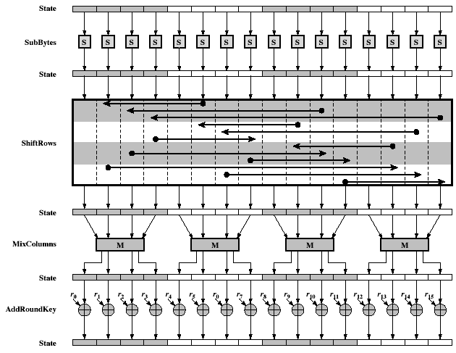
AES Round

Slide 15
AES Key Expansion
takes 128-bit (16-byte) key and expands into array of 44/52/60 32-bit words
start by copying key into first 4 words
then loop creating words that depend on values in previous & 4 places back
  in 3 of 4 cases just XOR these together
  every 4th has S-box + rotate + XOR constant of previous before XOR together
designed to resist known attacks
Notes:
Key expansion is designed to be simple to implement, but by using round constants break symmetries, and make it much harder to deduce other key bits if just some are known (but once have as many consecutive bits as are in key, can then easily recreate the full expansion).

Slide 16
AES Decryption
AES decryption is not identical to encryption since steps done in reverse
but can define an equivalent inverse cipher with steps as for encryption
  but using inverses of each step
  with a different key schedule
works since result is unchanged when
  swap byte substitution & shift rows
  swap mix columns & add (tweaked) round key
Notes:
By constructing an equivalent inverse cipher with steps in same order as for encryption, can derive a more efficient implementation. Clearly swapping the byte substitutions and shift rows has no effect, since work just on bytes. Swapping the mix columns and add round key steps requires the inverse mix columns step be applied to the round keys first – this makes the decryption schedule a little more complex with this construction.

Slide 17
Implementation Aspects
can efficiently implement on 8-bit CPU
  byte substitution works on bytes using a table of 256 entries
  shift rows is simple byte shifting
  add round key works on byte XORs
  mix columns requires matrix multiply in GF(2⁸) which works on byte values, can be simplified to use a table lookup

Slide 18
Implementation Aspects
can efficiently implement on 32-bit CPU
  redefine steps to use 32-bit words
  can precompute 4 tables of 256-words
  then each column in each round can be computed using 4 table lookups + 4 XORs
  at a cost of 16Kb to store tables
designers believe this very efficient implementation was a key factor in its selection as the AES cipher

Slide 19
Summary
have considered:
  the AES selection process
  the details of Rijndael – the AES cipher
  looked at the steps in each round
  the key expansion
  implementation aspects

